Slide 1
Technical Challenges, Ethical Concerns, and Future Opportunities in Interoperable Patient-Centric Medical Data Transfer
Ian Hay
Professor John Rachlin
7th December 2022

Slide 2
Electronic Health Records (EHRs)
Transition of paper-based medical records to electronic equivalents
Hospital adoption in 2008: 9%
Hospital adoption in 2022: >95% [1]
Clinical data more widely available than ever before
Creation of AI in healthcare
Growth of data-based solutions to medical problems
Transition has not been perfectly smooth
As of 2014, 15% of patients had to personally bring a test result to their physician
5% had to re-do a test due to unavailability of prior results [2]
[1] : https://www.ncbi.nlm.nih.gov/pmc/articles/PMC5565131/
[2] : https://journals.sagepub.com/doi/10.1177/1460458218769699

Slide 3
Medical Images
Represent a significant portion (80-90%) of all medical data
CT, MRI, Ultrasound, PET, X-Rays
Generate large, raw data files
Contain sensitive patient data – potential to identify patients from imaging data alone
Most common format: DICOM
Digital Images and Communications in Medicine
Metadata header
Raw pixel data as an array
Render final image using metadata and raw pixel information
E.g., for an MRI, metadata may contain the radioisotope injected, the bodyweight of the patient, and the positioning of the scanner

Slide 4
Challenges in Medical Image Data Engineering
Medical Images can be multi-dimensional
2D : X-Ray
3D : CT Scan
4D : MRIs taken across time
Medical Images are sensitive data
Contain identifying patient information and health data
Represents one of the biggest targets for cybersecurity breaches
Medical Images can be incredibly complex
A single patient may have tens of thousands of images for a single diagnosis
Feature vectors of these images can contain thousands of dimensions

Slide 5
Transferring Medical Image Data
As medical data has grown, more hospitals are outsourcing data storage to cloud servers
Data in transfer is most vulnerable
Two options to maintain HIPAA compliance:
Encrypt data before sending to storage
Contains full, raw image data
Ensures only key holder has access
Cannot process raw data without downloading on local machine
Anonymize image
Remove identifying features
Able to remotely render image
Not encrypted; does not contain totality of image data

Slide 6
How did we transition from paper to electronic health records?
The 1996 Health Insurance Portability and Accountability Act (HIPAA) established modern security and privacy guidelines for personal health information
Healthcare organizations and businesses are only allowed to disclose personal health information to the patient and their authorized representatives
Requires privacy-preserving data storage and transfer via encryption and anonymization
The US Government, through Medicare and Medicaid financial incentives, subsidized the adoption of EHRs
Health Information Technology for Economic and Clinical Health (HITECH) Act of 2009
Paid out $13 Billion from 2009-2013
Prioritized EHR adoption over interoperability
Extended security and privacy requirements for businesses associated with medical data
Implemented fines and legal consequences for non-compliance

Slide 7
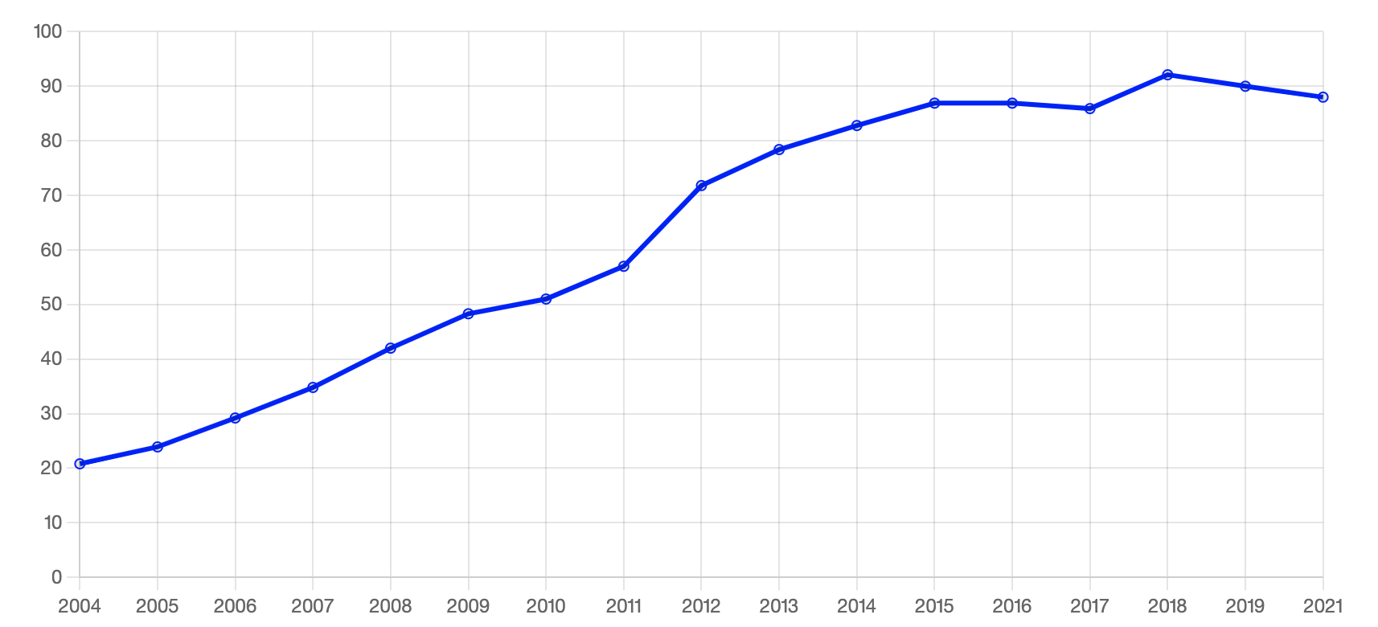
Current State of EHRs (in the US)
Hospital systems adopted proprietary data storage and management systems to preserve patient privacy and security
Medical data is among the most complex and challenging to standardize
Health Level 7 (HL7) Standard
V2: criticized for being too simplistic
Most widely used
V3: criticized for being complex and inconsistent
FHIR: Fast Health Interoperability Resources
Utilizes API structure to incentivize interoperability between systems
% Office-based Physician EHR Adoption
Source: HealthIT.gov
Notes:
https://www.healthit.gov/data/quickstats/office-based-physician-electronic-health-record-adoption

Slide 8
Transfer of EHR data between healthcare systems
Why do EHRs need to be transferred outside of a hospital’s system?
To get a collaborator’s medical opinion
To a patient’s new hospital
To share with clinical researchers for disease modeling
Data in transfer is at its most vulnerable
Medical data particularly sensitive due to personal, irrevocable nature of the data
Average of more than 1 medical data leak per day
Several initiatives designed to standardize medical data transfer
Integrating Health Enterprise (IHE): ITI-43 transaction standard
Health Information and Management Systems Society (HIMSS): Health Information Exchange (HIE) standards
Challenges remain in adopting universal standard between hospital system’s data silos

Slide 9
Technical Difficulties in Transferring Medical Images
Linking raw files to DICOM/rendered formats
There may be many raw files that render to a single DICOM file, and vice-versa
Linking reports to images
Reports are necessary to gain full context of the image
May be multiple reports tied to a single image – remains a challenge
Linking the patient to their image
Difficulties associated in validating and correcting the patient identifier tied to the image
Interoperability of above solutions
EHR data systems have been generated by medical data companies…
But the lack of standardization of solutions to the above problems has contributed to dismal interoperability for medical image transfers, particularly to hospitals/practices outside of the sender’s system

Slide 10
HIMSS-SIIMs Enterprise Imaging Community
Society for Imaging Informatics in Medicine
Developed 6 technical whitepapers for challenges in enterprise medical data, particularly surrounding medical images
Host yearly hackathons, workshops, and conferences

Slide 11
IHE: Integrating the Health Enterprise
Initiative for healthcare individuals and organizations to improve computer systems integration in medical professions
More general and broad organization than HIMSS-SIIM
Established cross-enterprise document sharing (XDS) exchange standards
XDS-I.b standard for medical image data sharing

Slide 12
Large corporations
Microsoft Azure
Offers cloud solutions for medical data storage and retrieval
Siemens
Image sharing and archiving software following IHE XDS standards
Integrates DICOM and HL7 standards
Phillips
Enterprise image sharing and viewing software with IHE’s XDS standards profile

Slide 13
Small start-ups
NextGen Healthcare
Offers open-source GitHub repo for handling HL7 medical data
Premium software service with FHIR compatibility and “interoperability”
PostDICOM
Medical image data sharing & viewing for individuals and small physicians
Offers web interface for data anonymization
Vaultara, Nuance, ShareMedix
All offer a data sharing platform for medical images
Unclear on the level of interoperability between members outside the same hospital network

Slide 14
What is a Blockchain?
Header: Previous block’s hash, block metadata
Message:
Transaction data
A distributed ledger of blocks connected by a chain of cryptographic hashes
Content of block n is dependent on content of block n-1
Hash of entire block’s content ensures tamper proofing
Cannot alter block content without changing the block’s hash
Cannot change the block’s hash without disrupting the chain
Diagram of a single block
Genesis Block
Hash₁
Hash₂
Hash₁
Hash₂
Hash₃
Diagram of a blockchain

Slide 15
Types of Blockchains
Permissioned
Nodes are not created equal
Allows for access control
Hyperledger Fabric most widely used permissioned blockchain
Open-source from the Linux Foundation
Used to form trusted, private networks
Permissionless
All nodes are created equal
Anyone can add to blocks
With a certain cost associated
Bitcoin, Ethereum are examples of permissionless blockchains
Used to form trustless, decentralized public networks

Slide 16
Where Can Blockchain Solve Medical Data Transfer Problems?
Current transfer systems require 3rd party clearinghouse to distribute transferred data
Must trust the clearinghouse
Blockchain enables peer-to-peer network capable of logging data transactions
Blockchain’s tamper proof nature and consensus mechanisms prevent unwarranted data transfer
Implementation of access control grants patients or organizations control over encryption keys and transfer permissions
Widespread implementation enables consistent adoption of medical image transfer standard
Participants must follow standard to participate in network

Slide 17
Challenges in Blockchain-based EHR Technology
Storing data on blockchain is computationally expensive
Each node must store the complete blockchain
Can store data off-chain and transfers on-chain
Blockchain only secures on-chain data
Need to design data storage and access mechanisms to fulfill security and privacy requirements
Data lifecycle
Infeasible to store all data permanently
Immutable nature of blockchain makes data lifecycle challenging
Off-chain storage can help solve this by enabling deletion of data after predetermined amount of time
Potentially enforceable by smart contracts

Slide 18
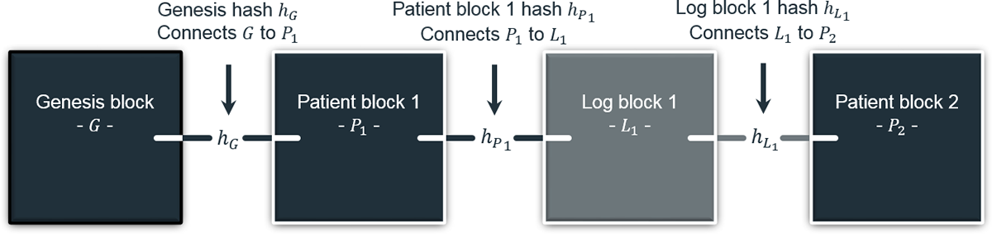
HealthChain
EHR exchange protocol desired for interoperability
Built around HL7 FHIR standard
Mixed-block approach
Trustless “Log Blocks” store history of data transfers (transactions)
Permissioned “Patient Blocks” handles access control of patient’s data
Proxy Re-Encryption (RPE) enables mutability – compliance with regulations
Notes:
R. H. Hylock and X. Zeng, “A Blockchain Framework for Patient-Centered Health Records and Exchange (HealthChain): Evaluation and Proof-of-Concept Study,” J Med Internet Res, vol. 21, no. 8, p. e13592, Aug. 2019, doi: 10.2196/13592.

Slide 19
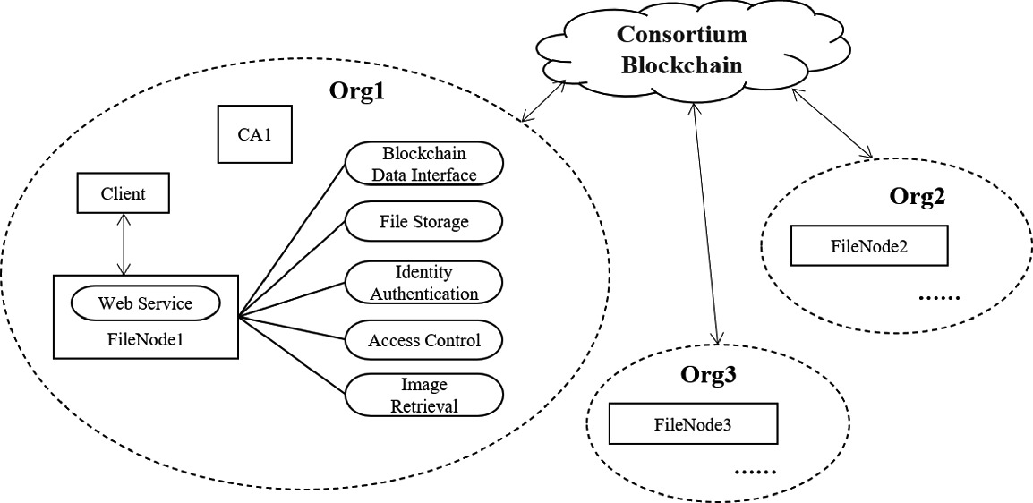
Medical Image File Sharing (MIFS)
Built around organizational-level FileNode’s
Each hospital operates their own node
Consortium blockchain handles data transactions
System built for sharing medical images for machine learning
Current systems severely limit medical image data for research

Slide 20
The Future of Electronic Health Record Exchange
EHRs prove difficult to transfer in their current state
Large, fragmented data silos
Encrypted cloud computing storage
New Standards developed to improve information exchange
HL7’s FHIR API standard
Adoption of this standard has proven slow
Developing a peer-to-peer network could enable interoperable transfer and incentivize these standards
Opportunity for blockchain-based approaches
Cannot solve transfer of data, only of access control permissions
Future work needed to connect blockchain-based networks to external cloud storage for real-world use

